Slide 1
Deploying Open5g applications on Kubernetes with continuous integration
PROJECT GUIDE: GROUP MEMBERS:
Debobroto Das Robin, Akhil Reddy Nalla (811172556)
Professor Divya Sri Karingula (811172271)

Slide 2
Overview
Introduction
Problem Statement & Solution
Technique used
Project Overview
System Architecture
Reference

Slide 3
Introduction
Open5g
This Open5g can be used to configure your own NR/LTE network. If gNB/eNB and USIM are available, you can build a private network using Open5GS.
Open5GS implemented 5GC and EPC using C-language and WebUI is provided for testing purposes and is implemented in Node.JS and React.

Slide 4
Problem Statement & Solution
Problem : Open5g Application developers can repeatedly build, test, and deploy newer versions of their applications, no matter where they are running and without any focus on Provisioning, Deploying Updating, Upgrading, availability & scalability
Solution : The main goal of this project is to create a platform to maintain Continuous integration , Continuous deployment and continuous testing for an Open5g system over cloud

Slide 5
Tools
Git
GitHub Code Repo
AWS Management Console
AWS Service like Ec2, EKS
Docker Engine
Docker Hub Registry
Kubernetes
Jenkins

Slide 6
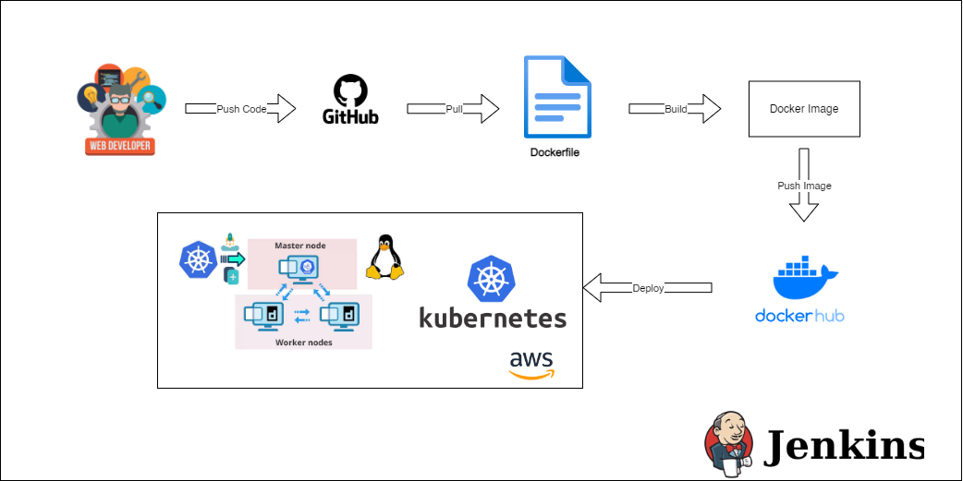
Planned System Architecture

Slide 7
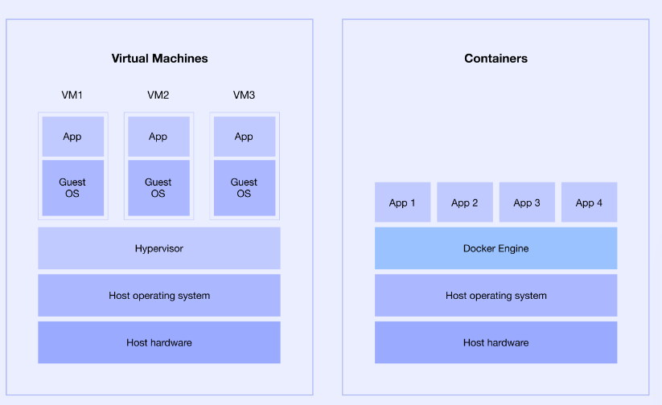
Virtual Machines VS Containers

Slide 8
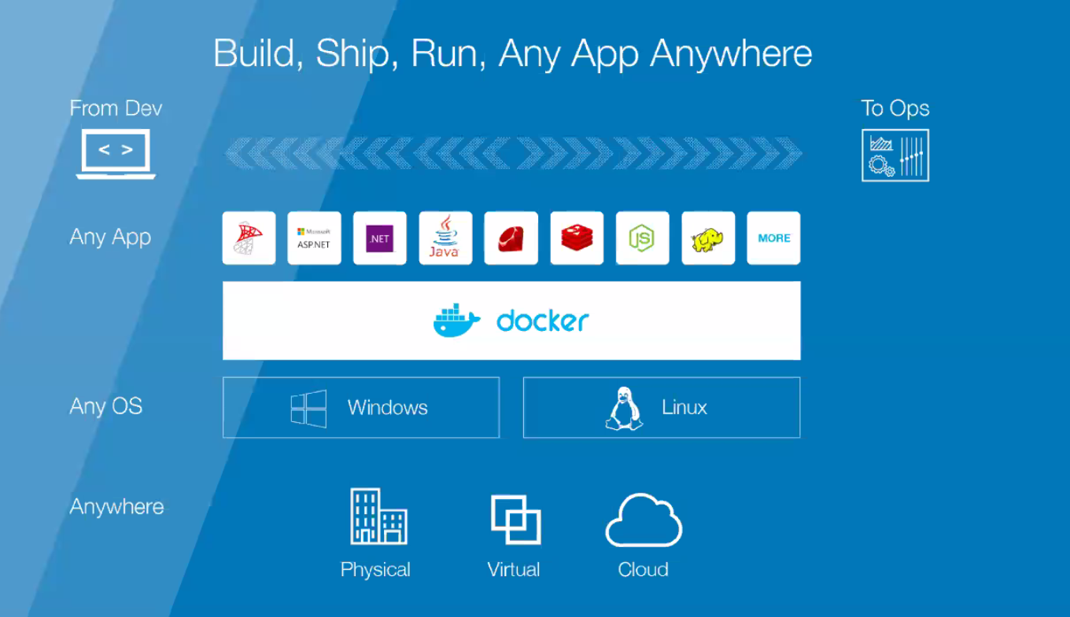
Docker
Write docker script for Docker files
Build Images
Run our images as a container
Use container for development
Configure CI/CD
Deploy and Monitoring our application

Slide 9
References
https://github.com/open5gs/open5gs
Nikolaos Apostolakis, Marco Gramaglia, and Pablo Serrano - Design and Validation of an Open Source Cloud Native Mobile Network
https://open5gs.org/open5gs
https://medium.com/rahasak/5g-core-network-setup-with-open5gs-and-ueransim-cd0e77025fd7
Docker Hub Account: https://hub.docker.com/u/akhilreddy62
GitHub Repo link: https://github.com/AkhilReddy62/open5g

Slide 10
Thank You.
www.kent.edu

